Slide 1
EAGRA -Automated Bugs Identification Through Early Access Game Review Analytics On Game Distribution Platforms
ALI SHAHBAZ (20I-2020)
DR. KHUBAIB AMJAD ALAM

Slide 2
Content
Introduction
Research gaps and Statement of research problem
Research Objectives and Questions
Research Methodology
Proposed Model
Model Evaluation
Contribution and Significance

Slide 3
Introduction

Slide 4
Introduction
Gaming industry has gained huge attention in the past few years.
Prior studies show that gamers are extremely hard to please, making the quality games an important issue.
Reviews can make or break a game [5], as other potential buyers often base their purchasing decisions on the reviews of a game.
Bugs that persist into releases of video games can have negative impacts on both developers and users.
Studying gamer reviews help developers better understand the concerns and further improve the user perceived quality.

Slide 5
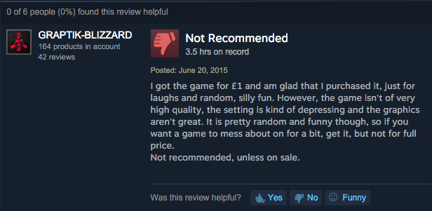
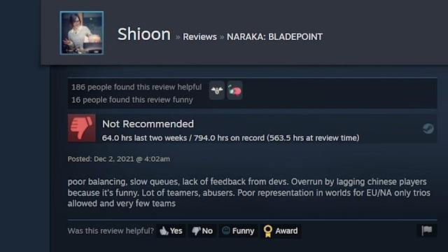
Research Background
The game industry has become one of the most profitable markets in the entertainment industry. Knowing what customers and users think and how they feel about a game is a central piece to drive the decision making process of any game developer or game studio, towards the user satisfaction [1]. Developing a successful game is challenging. Studying gamer reviews help developers better understand the concerns and further improve the user perceived quality.

Slide 6
Motivation
Reviews are helpful for developers to resolve issues and identify requirements to meet the end user’s expectations.
Manual analysis is impractical for a large number of reviews, received every day.
Initial work had limited to the identification of the game bugs related categories but limited scientific work exist on automated bug identification and classification.
One review can fall in more then one categories of bugs e.g. one review can contain more than one bug e.g. invalid positioning and artificial stupidity.
There is a need of automated mechanism which can take user reviews as an input then after training and modeling the data it can classify bugs into their related categories.

Slide 7





Feature Request
User Response
Game Review Split Down
Game Review
User Experience
Bug Report
User Suggestion

Slide 8
Problem Statement
General Problem
1
Several studies focused on mining and categorization of user-reviews into actionable software maintenance requests. Existing literature has focused on user response toward games, detection of bugs in reviews.
Research Gaps
2
But there is need of an automated tool which can mine the reviews and extract bugs from it and classify them in to bugs categories and then generate bugs report from it.
Core Problem
3
Existing studies have either focused on mere identification of bug categories, comprehensive coverage of diverse set of bug categories such as lag, freezing, save glitch etc. is non-existent in the extant literature.

Slide 9
Research Objectives
RO1
To gain insights of the existing classification methods that need to be addressed in the context of game rating analysis.
RO2
To evaluate the performance of deep learning models for multi-label text classification.
RO3
To automatically categorize gaming reviews into multiple bugs labels using deep learning models (CNN, RNN & LSTM).

Slide 10




Research Questions
Research Question#01
What is the most widely used classification approach for game reviews analysis?
Research Question#03
How reviews can be categorized into multiple label using deep learning approached CNN, RNN & LSTM?
Research Question#02
How do feature extraction impact the performance of deep learning classification models for gaming reviews?
Research Question#04
What are gamers talking about in gaming reviews?

Slide 11
Research Methodology

Slide 12




Research Methodology (K. Peffers, T. Tuunanen A design science research methodology)
Step 1
Step 2
Step 3
Step 4
Literature review for research gap analysis and for construction of initial list of evaluation factors.
Defining objectives of the solution.
Design and development of multiple deep learning models for multi-label classification model of reviews.
Evaluation of the proposed approach to determine the applicability in context of real world gaming application reviews.

Slide 13
Literature Review
Ref | Methodology/Approach | Strengths | Weaknesses | Dataset
[1] | Data mining based techniques (Mine the review based on phrases) | User opinions in reviews Phrases from reviews | Approach cannot extract opinions corresponding to textual expressions No classification and categorization of bugs | 120 mobile apps, 2944,335 crawled reviews
[3] | Deep Learning algorithms (sentiment analysis techniques) | Classification of app reviews into four types Bug reports, feature requests, user experiences, and text ratings | Limited to bug reports, feature only no method for bug classification | 1186 apps and 1,303,182 reviews
[4] | Static method unity linter tool | Unity games and projects | Static analysis is not particularly used to finding bugs in games No classification of bugs | 100 open source unity projects
[13] | Statistical Method (Descriptive statistical method) | User reviews to understand user requirements from store Aggregation and use of feedback | No identification of bugs from user reviews | App Store application reviews (1126453)

Slide 14
Literature Review
Ref | Methodology/Approach | Strengths | Weaknesses | Dataset
[6] | Statistical Method (Wilcoxon signed rank test) | Similarity check between game reviews characteristics with mobile app reviews characteristics | Only collected one month of reviews that have an accurate number of playing hours | 6224 applications
[12] | Game loop video | XML written template which generates a message based on game’s current state | GUI need to be reprogrammed for every game Detection of bugs in real time but no explanation for its classification | Five real world games
[8] | Supervised Machine Learning algorithms (Model based testing) | Model based testing to model the conceptual and behavioral details to be tested | Focused only on functional testing of the game Developers have to develop separate test ready models | 2D and 3D games
[11] | Statistical Method Tool (cosine similarity measure) | Bug fixes taken from app updates, Frequency of bugs in games | Manually evaluated these fixes to find the true recurring bugs | 30 Games, 12,122 bugs

Slide 15
Game Reviews Dataset
SCRAPY (fast high-level web crawling and web scraping framework, used to crawl websites and extract structured data from their pages) spiders used for the scrapping of reviews from the STEAM ENGINE. The features implemented are as follow:
Extract useful metadata from STEAM PRODUCT LISTING.
It crawls all user-submitted reviews of a particular product from the Steam community portal.
Automatically bypass Steam's age verification checkpoints.

Slide 16
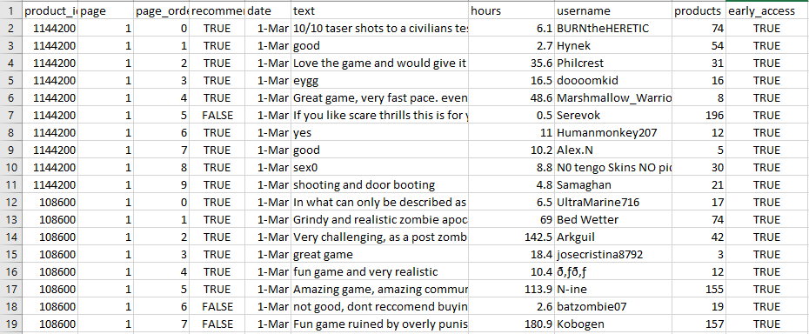
Game Reviews Dataset
Below is the image of scrapped game reviews using SCRAPY.

Slide 17
Dataset Labelling
As reviews labelling was required for gaming bugs classification in order to train a deep learning model. 10,000 gaming reviews of 15 different games of different categories labelled from gaming experts, who play games on daily basis and like to review the games.
Labelling Mechanism:
Labeling of reviews in fifteen different bugs categories of games j.Lewis taxonomy [10].
Reviews are labelled with corresponding bugs categories in the form of 0 and 1.

Slide 18
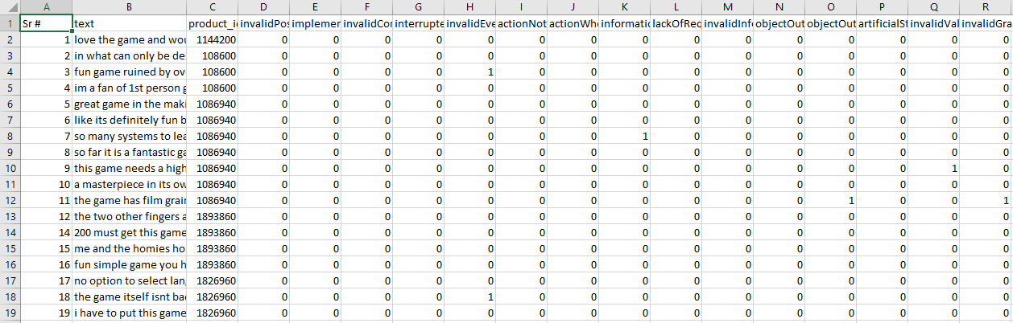
Game Reviews Labelled Dataset
Below is the image of gaming bugs labelled dataset.

Slide 19
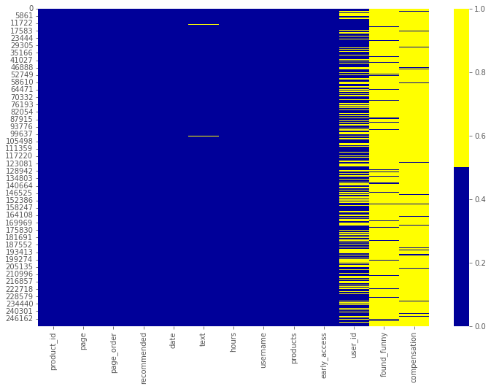
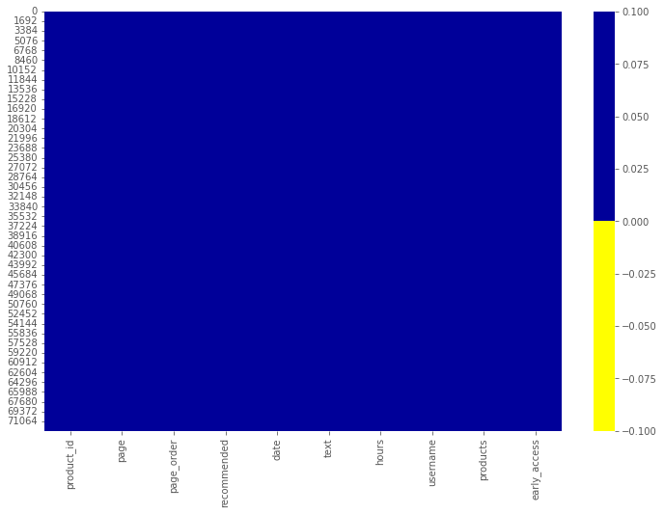
Reviews Pre-Processing
Crawled data had many inconsistencies which need to be resolved to get the accurate results because most of the ML and DL models results depends on the dataset consistency [12].
Dataset before and after applying pre-processing techniques:
Before Pre-Processing
After Pre-Processing

Slide 20
Pilot Studies
Multiple deep learning approaches are available for multi label text classification. But which perform best for the multi label text classification was unknown. Pilot studies of three different multiple deep learning models were conducted which are mostly used in literature for multi-label classification of reviews on 1500 gaming reviews dataset.
The models used for pilot studies are:
RNN(Recurrent neural network)
LSTM(Long short-term memory)
CNN(Convolutional neural network)

Slide 21
1. RNN(Recurrent neural network)
A Recurrent Neural Network (RNN) is a type of feed forward neural network in which the output of the previous step is provided as the input of the current step.
Implementation Steps:
Data set was divided into train set, validation set & test set.
Parameters are initialized which include input dimension, embedding dimension, hidden dimension, output dimensions and word embedding.
At first hidden state set to all zeros.
Mapped all indexes present in the input sequence of corresponding word vectors using our trained word embedding.

Slide 22
1. RNN(Recurrent neural network)
The results of the 3 epochs for the testing data set of 1500 reviews are presented in the below table:
Epochs | Accuracy | Val-Accuracy
1 | 0.6104 | 0.6000
2 | 0.6201 | 0.6198
3 | 0.6202 | 0.6101
Average | 0.6169 | 0.6099

Slide 23
2. LSTM(Long short-term memory)
LSTMs work much better due to hold over memorizing certain memory patterns.
Implementation Steps:
LSTM receives five arguments and have four dimensions. Four layers include
Output-Dim (Output layer: number of nodes in output layer will be same as input layer).
Hidden-Dim (Hidden layer: size of hidden layer. It the size of hidden-start of the LSTM).
Input-Dim (Total number of unique word in sample data).
Embedding-dim (Size of each embedding vector. Here embedding dimension of GloVe word embedding vectors is 100).

Slide 24
2. LSTM(Long short-term memory)
The results for the model accuracy for 1500 reviews for 3 epochs are given in the table below:
Epochs | Accuracy | Val-Accuracy
1 | 0.6404 | 0.6400
2 | 0.6401 | 0.6498
3 | 0.6402 | 0.6401
Average | 0.6402 | 0.6433

Slide 25
3. CNN(Convolutional neural network)
CNN is a type of artificial neural network, which is widely used for image/text recognition and classification. It can also be modified for multi-label text classification.
It is customized for multi-label bug classification model.
Implementation Steps:
Three layers of model are used which include pooling layer, convolutional layer and last one is the fully connected layer.
In the first layer which is pooling layer, dimensions of the feature map are reduced.
In the convolutional layer, filter map is applied on original dataset to feature maps in CNN model.
Fully connected layer contained the final model output which have connected nodes with the output labels.

Slide 26
3. CNN(Convolutional neural network)
The results of the 3 epochs for the testing data set of 1500 reviews are presented in the below table:
Epochs | Accuracy | Val-Accuracy
1 | 0.4904 | 0.4900
2 | 0.5001 | 0.4993
3 | 0.5002 | 0.5000
Average | 0.4969 | 0.4963

Slide 27
Proposed Research Methodology
Steam engine game platform used as a case study to collect reviews of different games using a custom crawler.
Pre-processing is done for a textual data to make it clean and ready for analysis.
Labelling of dataset by gaming experts.
NLP techniques including stop words removal, lemmatization and tokenization are used to process raw text of user reviews.
Then deep learning based multi-label review classifier LSTM(performed best in pilot study) is implemented for classification of reviews into defined set of labels.
Model is later tested and evaluated using real world example reviews.

Slide 28
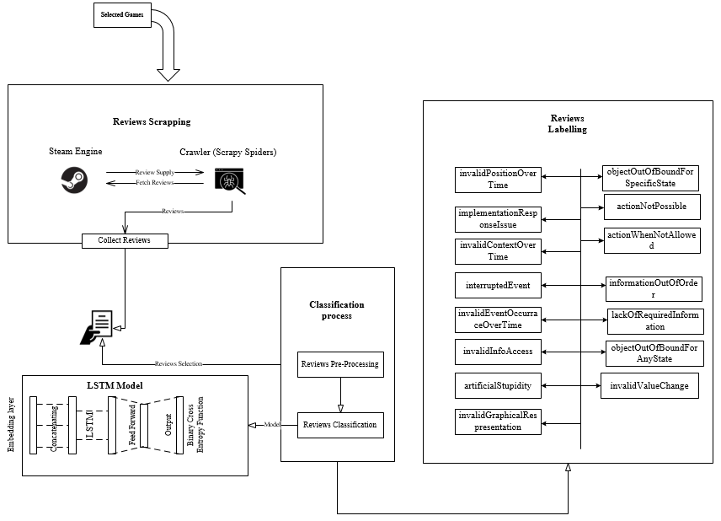
Architecture Of The Proposed Approach

Slide 29
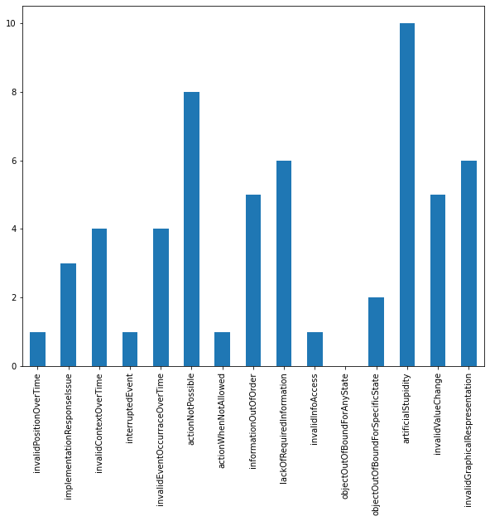
Bugs occurrence in pre-trained dataset

Slide 30
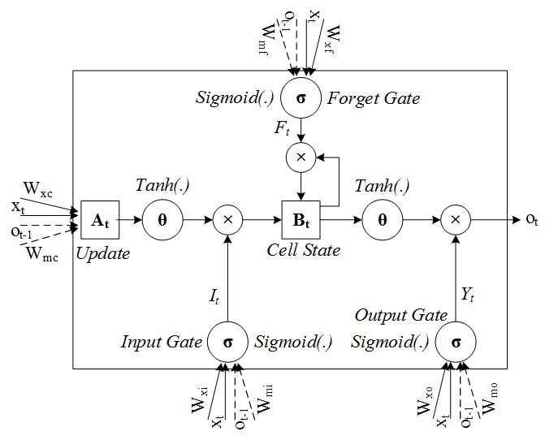
LSTM Architecture
It basically consist of three gates:
Forget gate
Input gate
Output gate

Slide 31
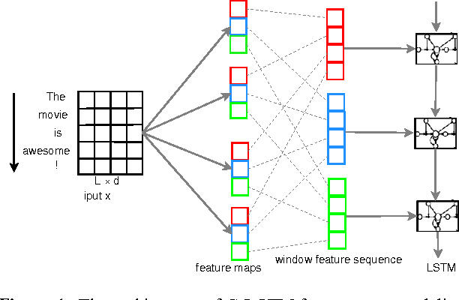
Model Design
The visual representation of LSTM layers discussed in pilot study section is shown below:

Slide 32
Implementation and Evaluation
Initially model was trained on 1500 reviews as described in pilot study section. Later model is trained over 10,000 labelled reviews in which 8000 reviews were used for training and 2000 reviews are used for validation (80/20 rule).
Detailed results of each epoch (hyper parameter that defines the number times that the learning algorithm will work through the entire training dataset) are shown in below table.
Epochs | Accuracy | Val-Accuracy
1 | 0.8234 | 0.8219
2 | 0.8237 | 0.8222
3 | 0.8344 | 0.8329
Average | 0.8271 | 0.8256

Slide 33
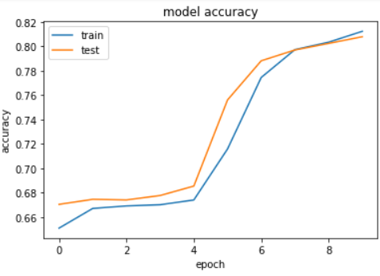
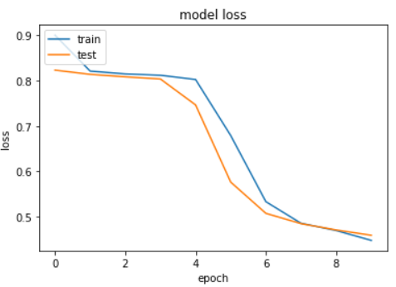
Model Accuracy and Loss
Model Accuracy
Model Loss

Slide 34
Research Contribution
Multi-label bug classification model for gaming app reviews has developed to support both game developers and researchers.
Extraction of bugs from the reviews helps developers and gaming organizations to make improvements in games.
Gamers express more than one issue in a single review which can be solved by this proposed solution.

Slide 35
Limitation and future work
In the context of ongoing work the proposed multi-label bug classification model focuses mainly on classifying the bugs into fifteen categories which are defined in existing literature [10].
Number of epochs are set to minimum which can also be increased to achieve the better results.
GloVe word embedding technique however other embedding techniques like word2Vec can also be used.
The proposed model is evaluated on the basis of accuracy other factors can also be considered to measure its performance.
Gaming bugs labeled dataset can be used for other research purposes too.

Slide 36
References
[1] P. M. Vu, H. V Pham, T. T. Nguyen, and T. T. Nguyen, “Phrase-based extraction of user opinions in mobile app reviews,” in 2016 31st IEEE/ACM International Conference on Automated Software Engineering (ASE), 2016, pp. 726–731.
[2] M. Nayrolles and A. Hamou-Lhadj, “Towards a classification of bugs to facilitate software maintainability tasks,” Proc. - Int. Conf. Softw. Eng., pp. 25–32, 2018, doi: 10.1145/3194095.3194101.
[3] W. Maalej, Z. Kurtanović, H. Nabil, and C. Stanik, “On the automatic classification of app reviews,” Requir. Eng., vol. 21, no. 3, pp. 311–331, 2016, doi: 10.1007/s00766-016-0251-9.
[4] A. Borrelli, V. Nardone, G. A. Di Lucca, G. Canfora, and M. Di Penta, “Detecting Video Game-Specific Bad Smells in Unity Projects,” Proc. - 2020 IEEE/ACM 17th Int. Conf. Min. Softw. Repos. MSR 2020, pp. 198–208, 2020, doi: 10.1145/3379597.3387454.
[5] J. Bergdahl, C. Gordillo, K. Tollmar, and L. Gisslén, “Augmenting Automated Game Testing with Deep Reinforcement Learning,” in 2020 IEEE Conference on Games (CoG), 2020, pp. 600–603, doi: 10.1109/CoG47356.2020.9231552.
[6] D. Lin, C. P. Bezemer, Y. Zou, and A. E. Hassan, An empirical study of game reviews on the Steam platform, vol. 24, no. 1. Empirical Software Engineering, 2019.

Slide 37
References
[7] A. C. Barus, R. Deddy Hasiholan Tobing, D. N. Pratiwi, S. A. Damanik, and J. Pasaribu, “Mobile game testing: Case study of a puzzle game genre,” Proc. 2015 Int. Conf. Autom. Cogn. Sci. Opt. Micro Electro-Mechanical Syst. Inf. Technol. ICACOMIT 2015, pp. 145–149, 2016, doi: 10.1109/ICACOMIT.2015.7440194.
[8] S. Iftikhar, M. Z. Iqbal, M. U. Khan, and W. Mahmood, “An automated model based testing approach for platform games,” in 2015 ACM/IEEE 18th International Conference on Model Driven Engineering Languages and Systems (MODELS), 2015, pp. 426–435, doi: 10.1109/MODELS.2015.7338274.
[9] D. Lin, C. P. Bezemer, and A. E. Hassan, “Identifying gameplay videos that exhibit bugs in computer games,” Empir. Softw. Eng., vol. 24, no. 6, pp. 4006–4033, 2019, doi: 10.1007/s10664-019-09733-6.
[10] C. Lewis, J. Whitehead, and N. Wardrip-Fruin, “What went wrong: A taxonomy of video game bugs,” FDG 2010 - Proc. 5th Int. Conf. Found. Digit. Games, pp. 108–115, 2010, doi: 10.1145/1822348.1822363.
[11] A. Truelove, E. S. de Almeida, and I. Ahmed, “We’ll Fix It in Post: What Do Bug Fixes in Video Game Update Notes Tell Us?,” in 2021 IEEE/ACM 43rd International Conference on Software Engineering (ICSE), 2021, pp. 736–747, doi: 10.1109/ICSE43902.2021.00073.

Slide 38
References
[12] S. Varvaressos, K. Lavoie, A. B. Massé, S. Gaboury, and S. Hallé, “Automated Bug Finding in Video Games: A Case Study for Runtime Monitoring,” in 2014 IEEE Seventh International Conference on Software Testing, Verification and Validation, 2014, pp. 143–152, doi: 10.1109/ICST.2014.27.
[13] D. Pagano and W. Maalej, “User feedback in the appstore: An empirical study,” in 2013 21st IEEE International Requirements Engineering Conference (RE), 2013, pp. 125–134, doi: 10.1109/RE.2013.6636712.
[14] Y. Liu, Y. Li, Y. Guo, and M. Zhang, “Stratify Mobile App Reviews: E-LDA Model Based on Hot ‘Entity’ Discovery,” in 2016 12th International Conference on Signal-Image Technology & Internet-Based Systems (SITIS), 2016, pp. 581–588, doi: 10.1109/SITIS.2016.97.

Slide 39
Early Access Games review example of STEAM ENGINE

